Slide 1
Open Banking Safety
and Fraud Mitigation
By
Chirudeep Pasumarthi,
Vishant Anand,
Yeshwanth Chowdhary Mineni
Under Guidance Of
Professor Reda Mastouri

Slide 2
Abstract
Open Banking Focus:
Financial institutions integrate with third-party apps for enhanced consumer interactions.
Fraud Mitigation Goal:
Prioritize fraud prevention at the open banking level.
Machine Learning Approach:
Apply ML techniques to identify and understand anomalies.
Research Objective:
Explore various anomalies in open banking processes.
Best Practices Implementation:
Implement ML-driven insights for robust anti-fraud measures.
Benefits:
Strengthened fraud detection.
Enhanced security in open banking.
Improved consumer trust.

Slide 3
Business need
Business Focus:
Enhancing API integration for operational efficiency.
Consumer-Centric Approach:
Creating a faster and seamless interface for consumers.
Credibility Preservation:
Ensuring no compromise on the originality and credibility of financial services.
Objective:
Improve speed while upholding service authenticity.
Business Advancement:
Facilitating a win-win situation for all parties involved.
Benefits:
Enhanced user experience.
Maintained credibility of financial services.
Increased efficiency for all stakeholders.

Slide 4
Data source
https://open.canada.ca/data/en/dataset/2061075a-55fe-47a5-be2f-984f12fc0d40

Slide 5
Problem statement
Objective:
Ensure safety in open banking transactions by mitigating fraud risks and enhancing user confidence.
Approach:
Implement advanced anomaly detection.
Develop comprehensive reporting features.
Design a user-centric dashboard with real-time notifications.
Benefits:
Proactive fraud mitigation.
Transparent and user-friendly experience.
Increased confidence among users and financial entities.

Slide 6
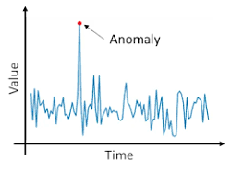
Minimum Viable Product(MVP)
The following are the MVP’S we want to work on and improve further on :
Data aggregation
Anomaly detection
Alerting reporting
User-friendly interfacing
Image reference: https://www.analyticsvidhya.com/blog/2021/06/univariate-anomaly-detection-a-walkthrough-in-python/

Slide 7
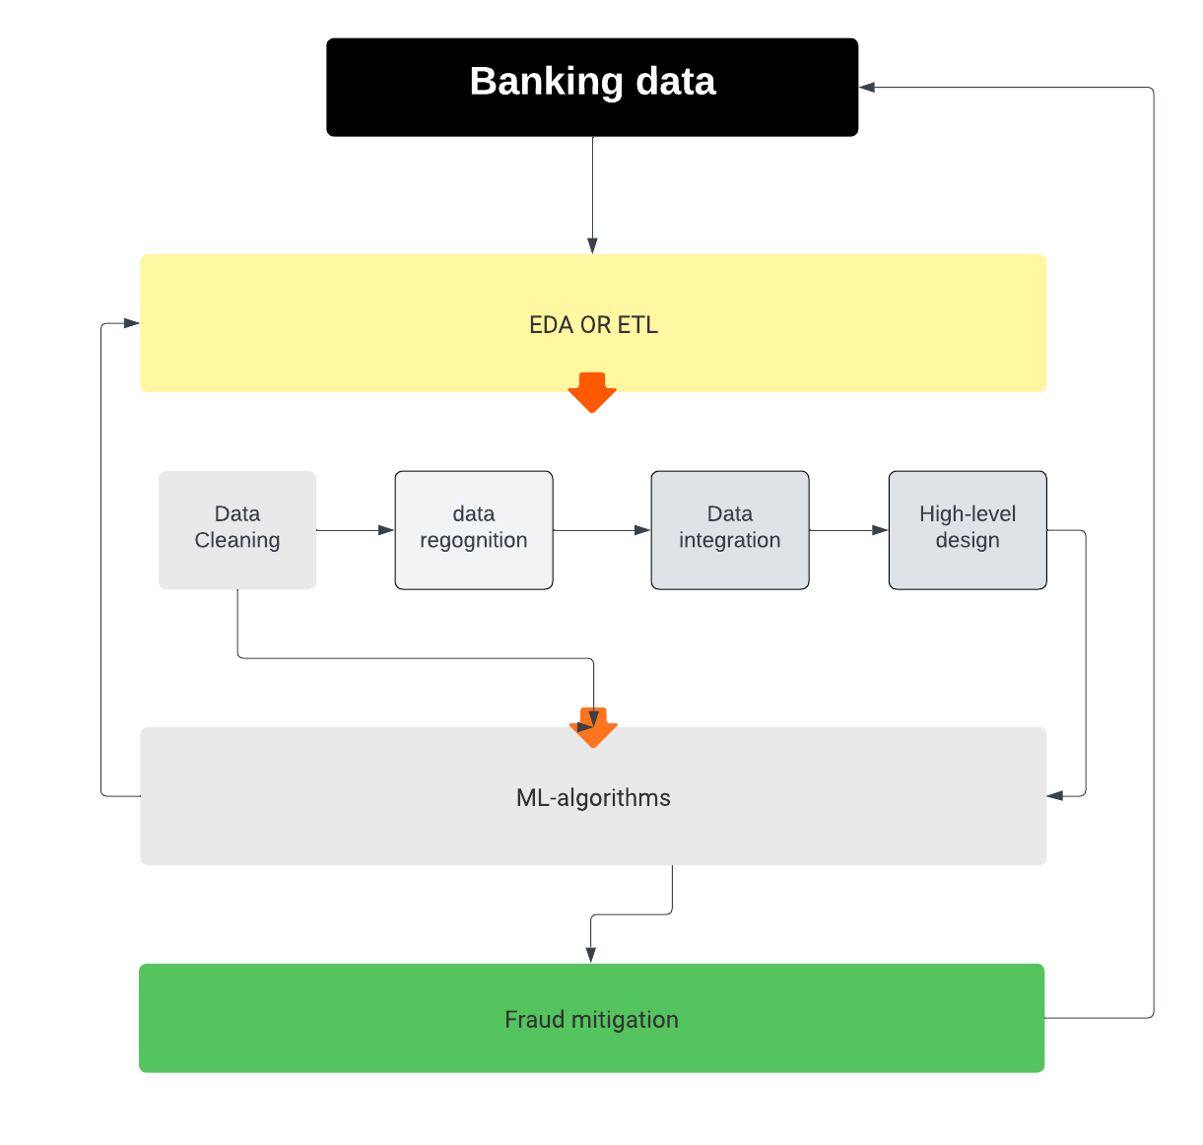
High Level Design

Slide 8
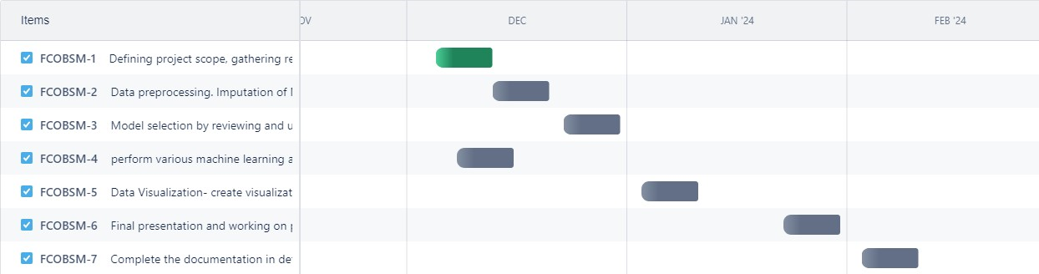
Gantt Chart
https://ymineni.atlassian.net/jira/core/projects/FCOBSM/list?direction=ASC&filter=%22assignee%22+%3D+%27712020%3Acabe234c-a1e8-4c1a-b423-aa852a9e11d5%27&sortBy=assignee&atlOrigin=eyJpIjoiMDBlOGVkM2I5MjM3NDdmN2IyZjM1MzBiOGRiMTBhM2QiLCJwIjoiaiJ9

Slide 9
Model selection
As we have selected these models for the further analysis:
Logistic Regression
Random forest analysis
XG boost
NLP classifier

Slide 10
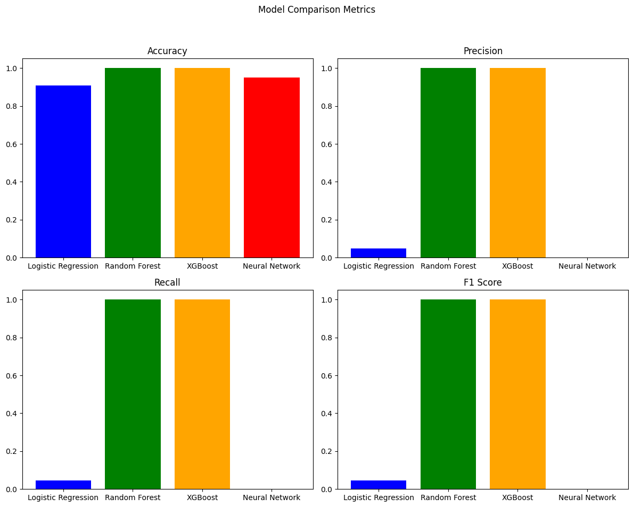
Model performance

Slide 11
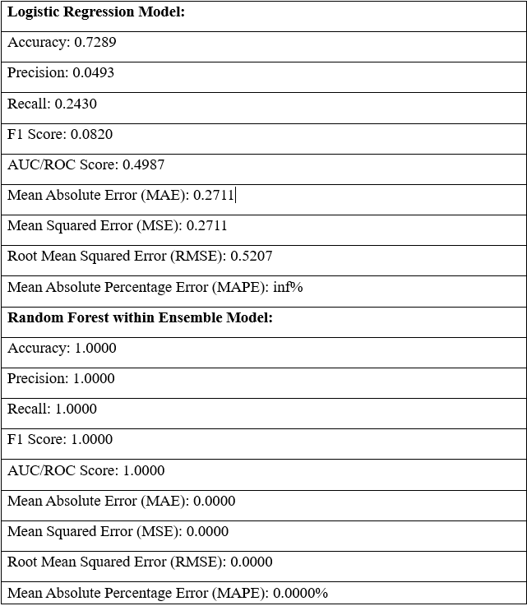
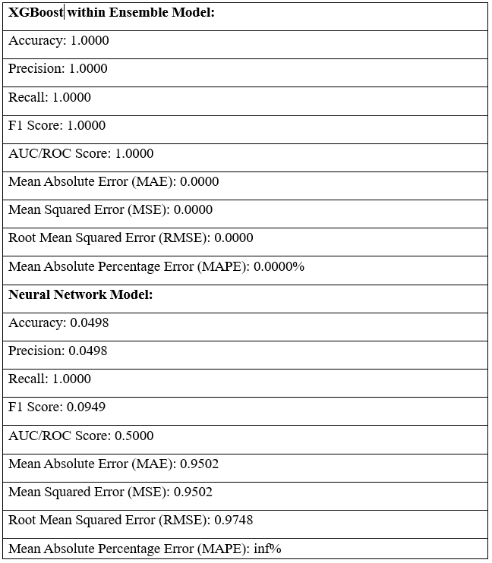
Metrics

Slide 12
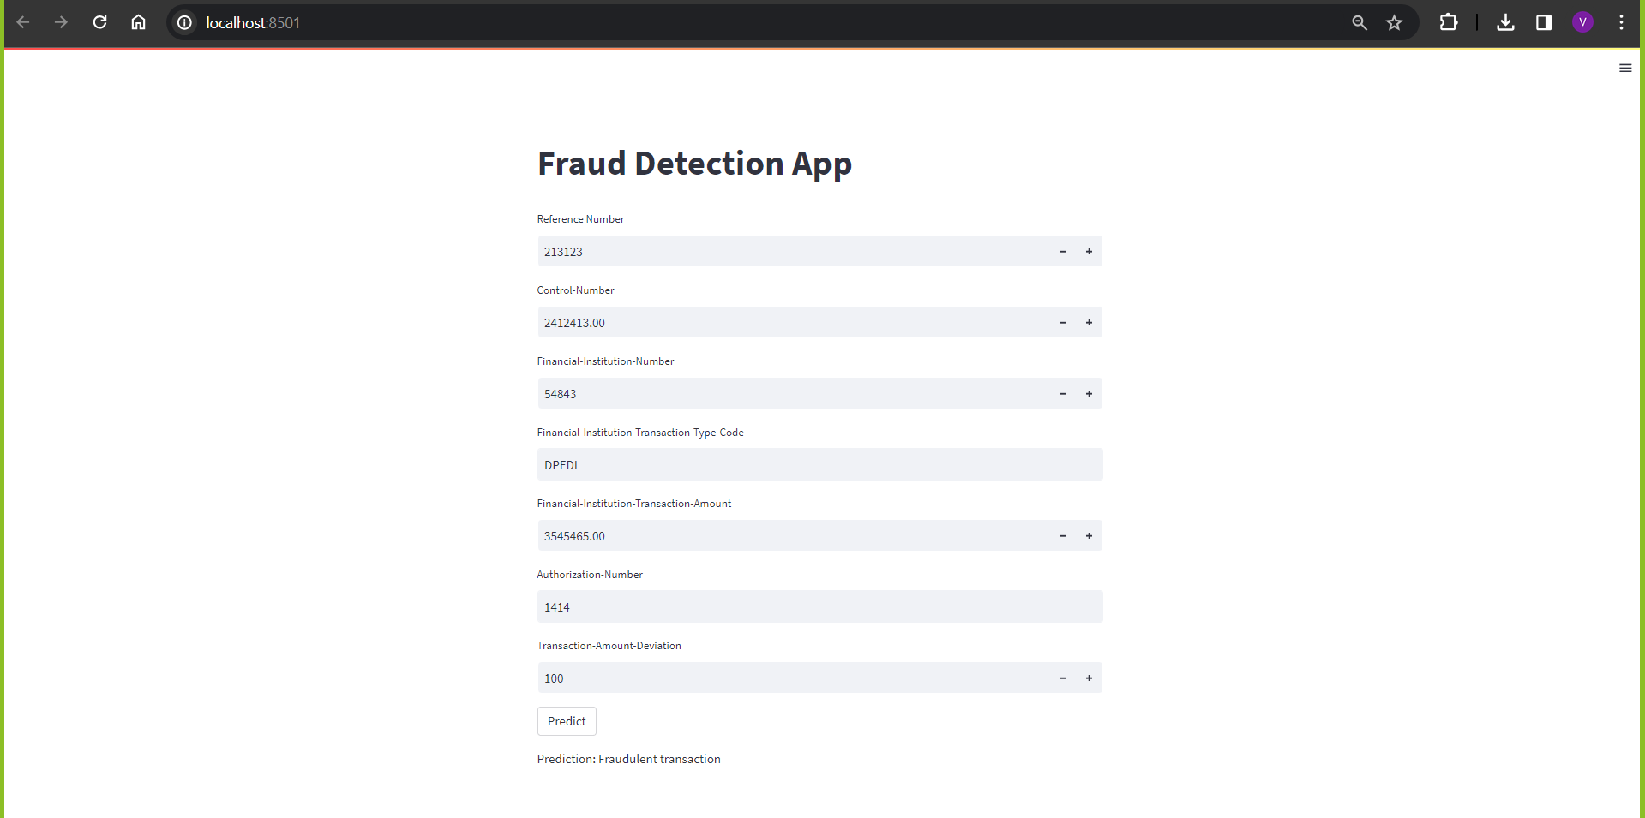
App Deployment

Slide 13
References
1. Ali, A., Razak, S. A., Othman, S. H., Eisa, T. a. E., Al-Dhaqm, A., Nasser, M., Elhassan, T., Elshafie, H., & Saif, A. (2022). Financial Fraud Detection Based on Machine Learning: A Systematic Literature review. Applied Sciences, 12(19), 9637. https://doi.org/10.3390/app12199637
2. Boulieris, P., Pavlopoulos, J., Xenos, A., & Vassalos, V. (2023). Fraud detection with natural language processing. Machine Learning. https://doi.org/10.1007/s10994-023-06354-5
3. Sanusi, Z. M., Rameli, M. N. , & Isa, Y. M. (2015). Fraud schemes in the banking Institutions: Prevention measures to avoid severe financial loss. Procedia. Economics and Finance, 28, 107–113.
https://doi.org/10.1016/s2212-5671(15)01088-6
4. Othman, R., Aris, N. A., Mardziyah, A., Zainan, N., & Amin, N. M. (2015). Fraud detection and prevention methods in the Malaysian public sector: Accountants’ and internal auditors’ perceptions. Procedia. Economics and Finance, 28, 59–67. https://doi.org/10.1016/s2212-5671(15)01082-5
5. Boulieris, P., Pavlopoulos, J., Xenos, A., & Vassalos, V. (2023b). Fraud detection with natural language processing. Machine Learning. https://doi.org/10.1007/s10994-023-06354-5
6. Mytnyk, B., Tkachyk, O., Shakhovska, N., Fedushko, S., & Syerov, Y. (2023). Application of artificial intelligence for fraudulent banking operations recognition. Big Data and Cognitive Computing, 7(2), 93. https://doi.org/10.3390/bdcc7020093
7. Afriyie, J. K., Tawiah, K., Pels, W. A., Addai-Henne, S., Dwamena, H. A., Owiredu, E. O., Ayeh, S. A., & Eshun, J. (2023). A supervised machine learning algorithm for detecting and predicting fraud in credit card transactions. Decision Analytics Journal, 6, 100163. https://doi.org/10.1016/j.dajour.2023.100163
8. Fraud and financial crimes: Regulatory challenges. (n.d.). KPMG. https://kpmg.com/us/en/articles/2022/ten-key-regulatory-challenges-2022-fraud-financial-crimes.html
9. Jendruszak, B., & Jendruszak, B. (2023, April 11). Risks of open banking Fraud & How to protect yourself in 2023. SEON. https://seon.io/resources/open-banking-risk-and-fraud/

